Slide 1
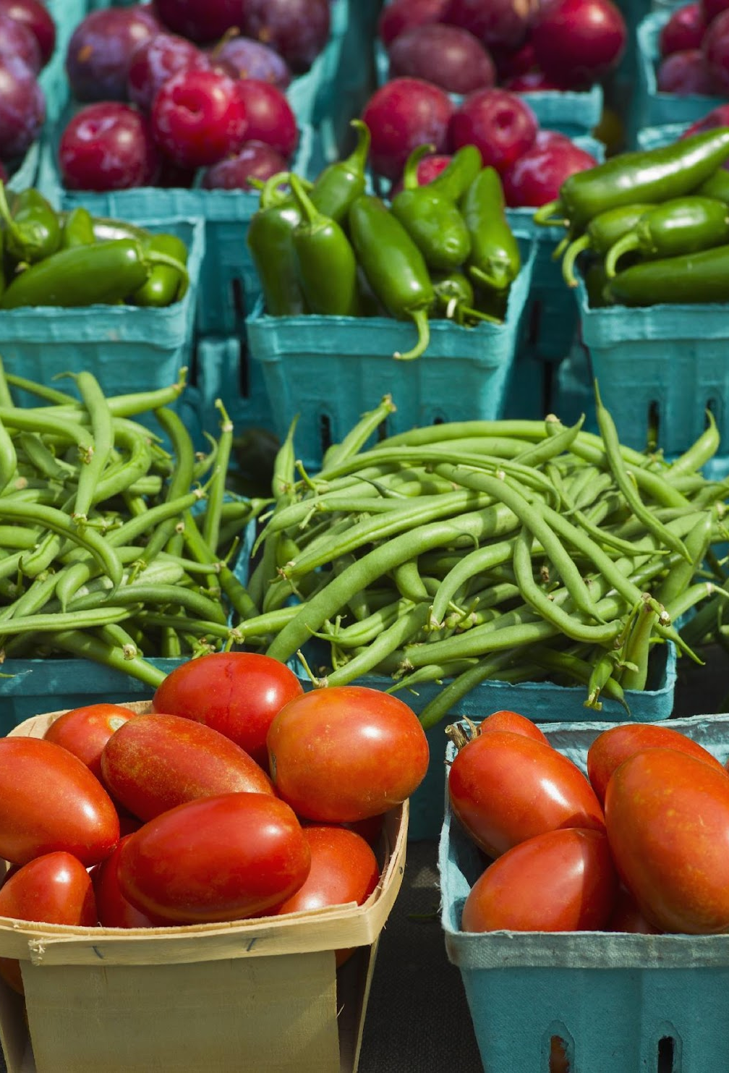
Using Machine Learning to Understand Housing Prices in California with Low Food Access
Yahel, Mhaire, Ryan, Aidan, and Liya

Slide 2

Agenda
Background
Objective & Questions
Methods and Materials
Results
Conclusions & Limitations
Recommendations
Sources

Slide 3
Background
What is a food desert?
“geo­graph­ic areas where res­i­dents have few to no con­ve­nient options for secur­ing afford­able and healthy foods — espe­cial­ly fresh fruits and veg­eta­bles.
Dis­pro­por­tion­ate­ly found in high-pover­ty areas, food deserts cre­ate extra, every­day hur­dles that can make it hard­er for kids, fam­i­lies and com­mu­ni­ties to grow healthy and strong.”
10%of the approximately 65,000 census tracts in the United States are food deserts

Slide 4
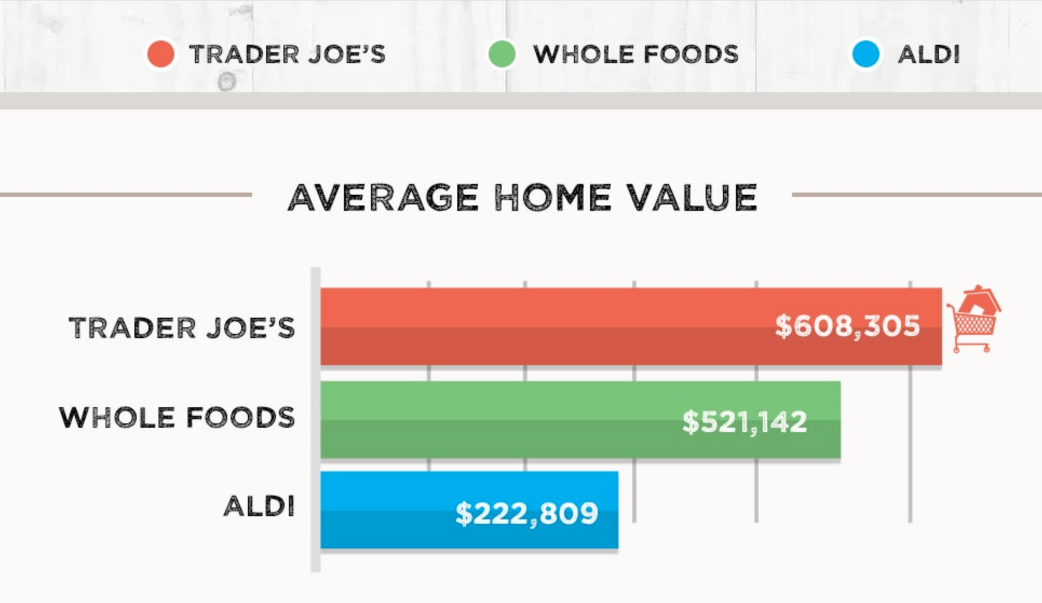
Background
What is the connection between housing prices and food access?
ATTOM Data Solutions analyzed the average home values, 5-year home price appreciation from YTD 2019 vs 2014, etc of 1,859 zip codes nationwide

Slide 5

How did we get here?
Immigration on Housing Prices and Houselessness
Housing Prices on Houselessness in California
Impact of Organic Food vs Fast Food business on Housing Prices in California
Understanding Relationship between Low food access areas and Housing Prices
Wanted to understand how the immigration and migration impacted housing
Wanted to know if housing prices impacted houselessness over the last 20 years
Areas of with whole foods and trader joes vs areas with only fast food locations impact housing market
Decided to study census data collected on low food access and housing prices using publically available data

Slide 6
What were our study questions?
Does being in a low food access area

Slide 7
Methods & Materials
Data Acquisition and Cleaning
Google Searches
Web Scraping
Jupyter Notebook/Pandas
Data Management
SQL/SQLite
Machine Learning
Linear Regression

Slide 8


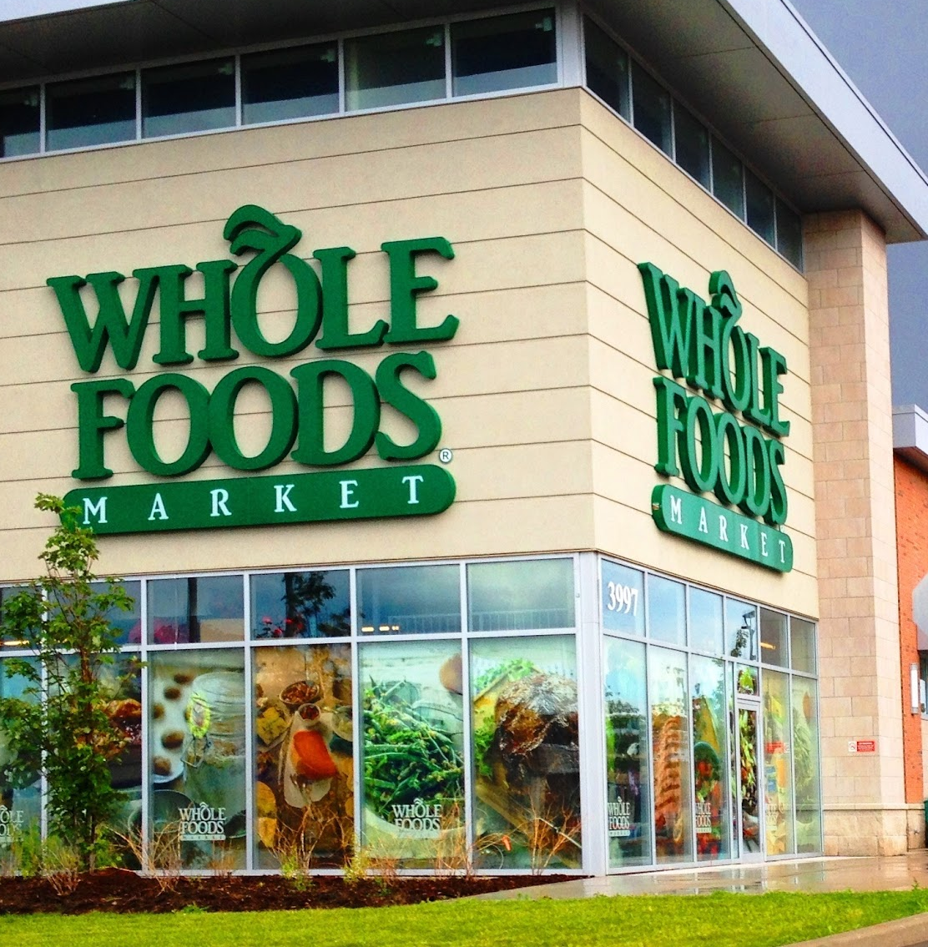
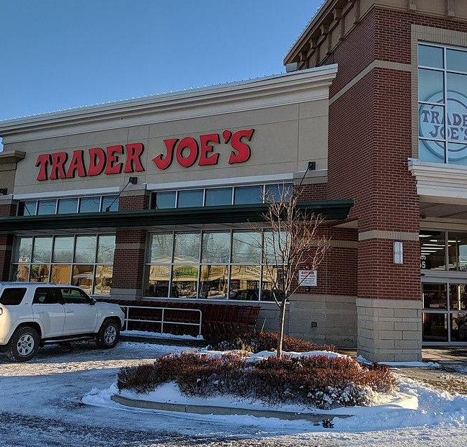

What kind of data did we use?
Data | Details | Used For | Origin
Low Food Access |  | Machine Learning | US Census
Housing Prices |  | Machine Learning | Zillow
Whole Foods Locations |  | Data Visualizations | Web-scraping
Trader Joe’s Locations |  | Data Visualizations | Google/Web-scraping
Burger King & McDonald’s Locations |  | Data Visualizations | Web-scraping

Slide 9

Results
What did we learn?

Slide 10
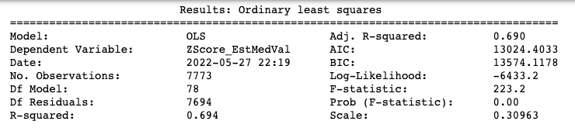
Machine Model Results

Slide 11
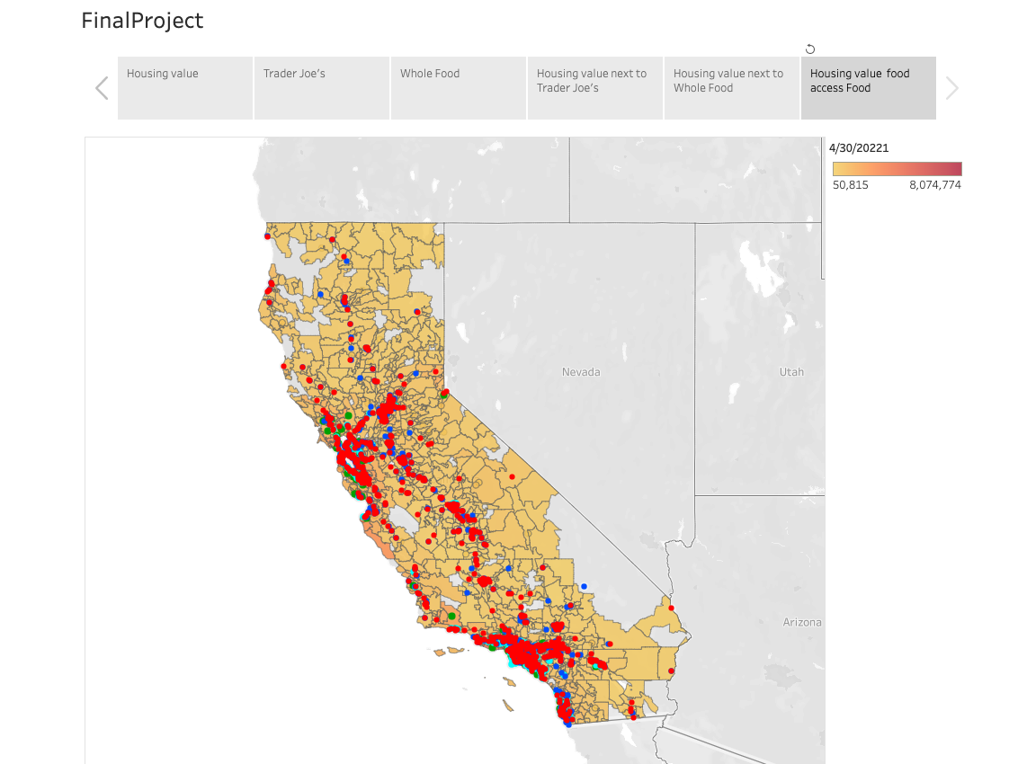
Data Visualization
Notes:
https://public.tableau.com/app/profile/yahel.epel/viz/Final_project_1test/FinalProject

Slide 12
Conclusion & Limitations

Slide 13
Recommendations

Slide 14
Sources
This is how grocery chains affect a home’s value
Does the New Whole Foods in Your Neighborhood Increase Your Home Value?

